Slide 1
CSI3344 Distributed Systems
Lecture 8
REPLICATION
Contents
8.1 Replica Distribution
8.2 Update Propagation
8.3 Consistency Protocols
Major Points

Slide 2
CSI3344 Distributed Systems
Objectives
Be aware of classifications of replicas;
Be familiar with approaches in propagating updates in distributed and replicated data store;
Be aware of the features of consistency protocols.

Slide 3
Introduction
Reasons for Replication
Data are replicated to increase the reliability of a system
Replication for performance
Scaling in numbers
Scaling in geographical area
Balance
Gain in performance
Cost of increased bandwidth for maintaining replication and consistency.
Notes:
Use a message to Daniel
Message is written (start data communication)
Choose mail or fax (processes)
Fax to company
Daniel (not only one) Sumich (D S, not Peter S)
Department/company
Fax number
Mail to
Daniel (not only one) Sumich (D S, not Peter S)
Department/company
Address

Slide 4
Introduction
To keep replicas consistent, we need to propagate updates in such a way that temporary inconsistencies are not noticed.
This leads to the introduction of replica distribution and update propagation.
Consistency protocols describe the implementations of consistency models
covered in last module.
Notes:
Use a message to Daniel
Message is written (start data communication)
Choose mail or fax (processes)
Fax to company
Daniel (not only one) Sumich (D S, not Peter S)
Department/company
Fax number
Mail to
Daniel (not only one) Sumich (D S, not Peter S)
Department/company
Address

Slide 5
8.1 Replica Distribution (1)
A major issue for replication in distributed data stores is to decide where, when, and by whom copies of the data store are to be placed.
Replicas in a data store can be classified into three types
Permanent
Server-initiated, and
Client-initiated.
Notes:
Copies of replicated data may be inconsistent when one copy is modified.
The modification has to be carried out on all copies to ensure consistency.
When and how to carry out the modification determines the price/cost of replication

Slide 6
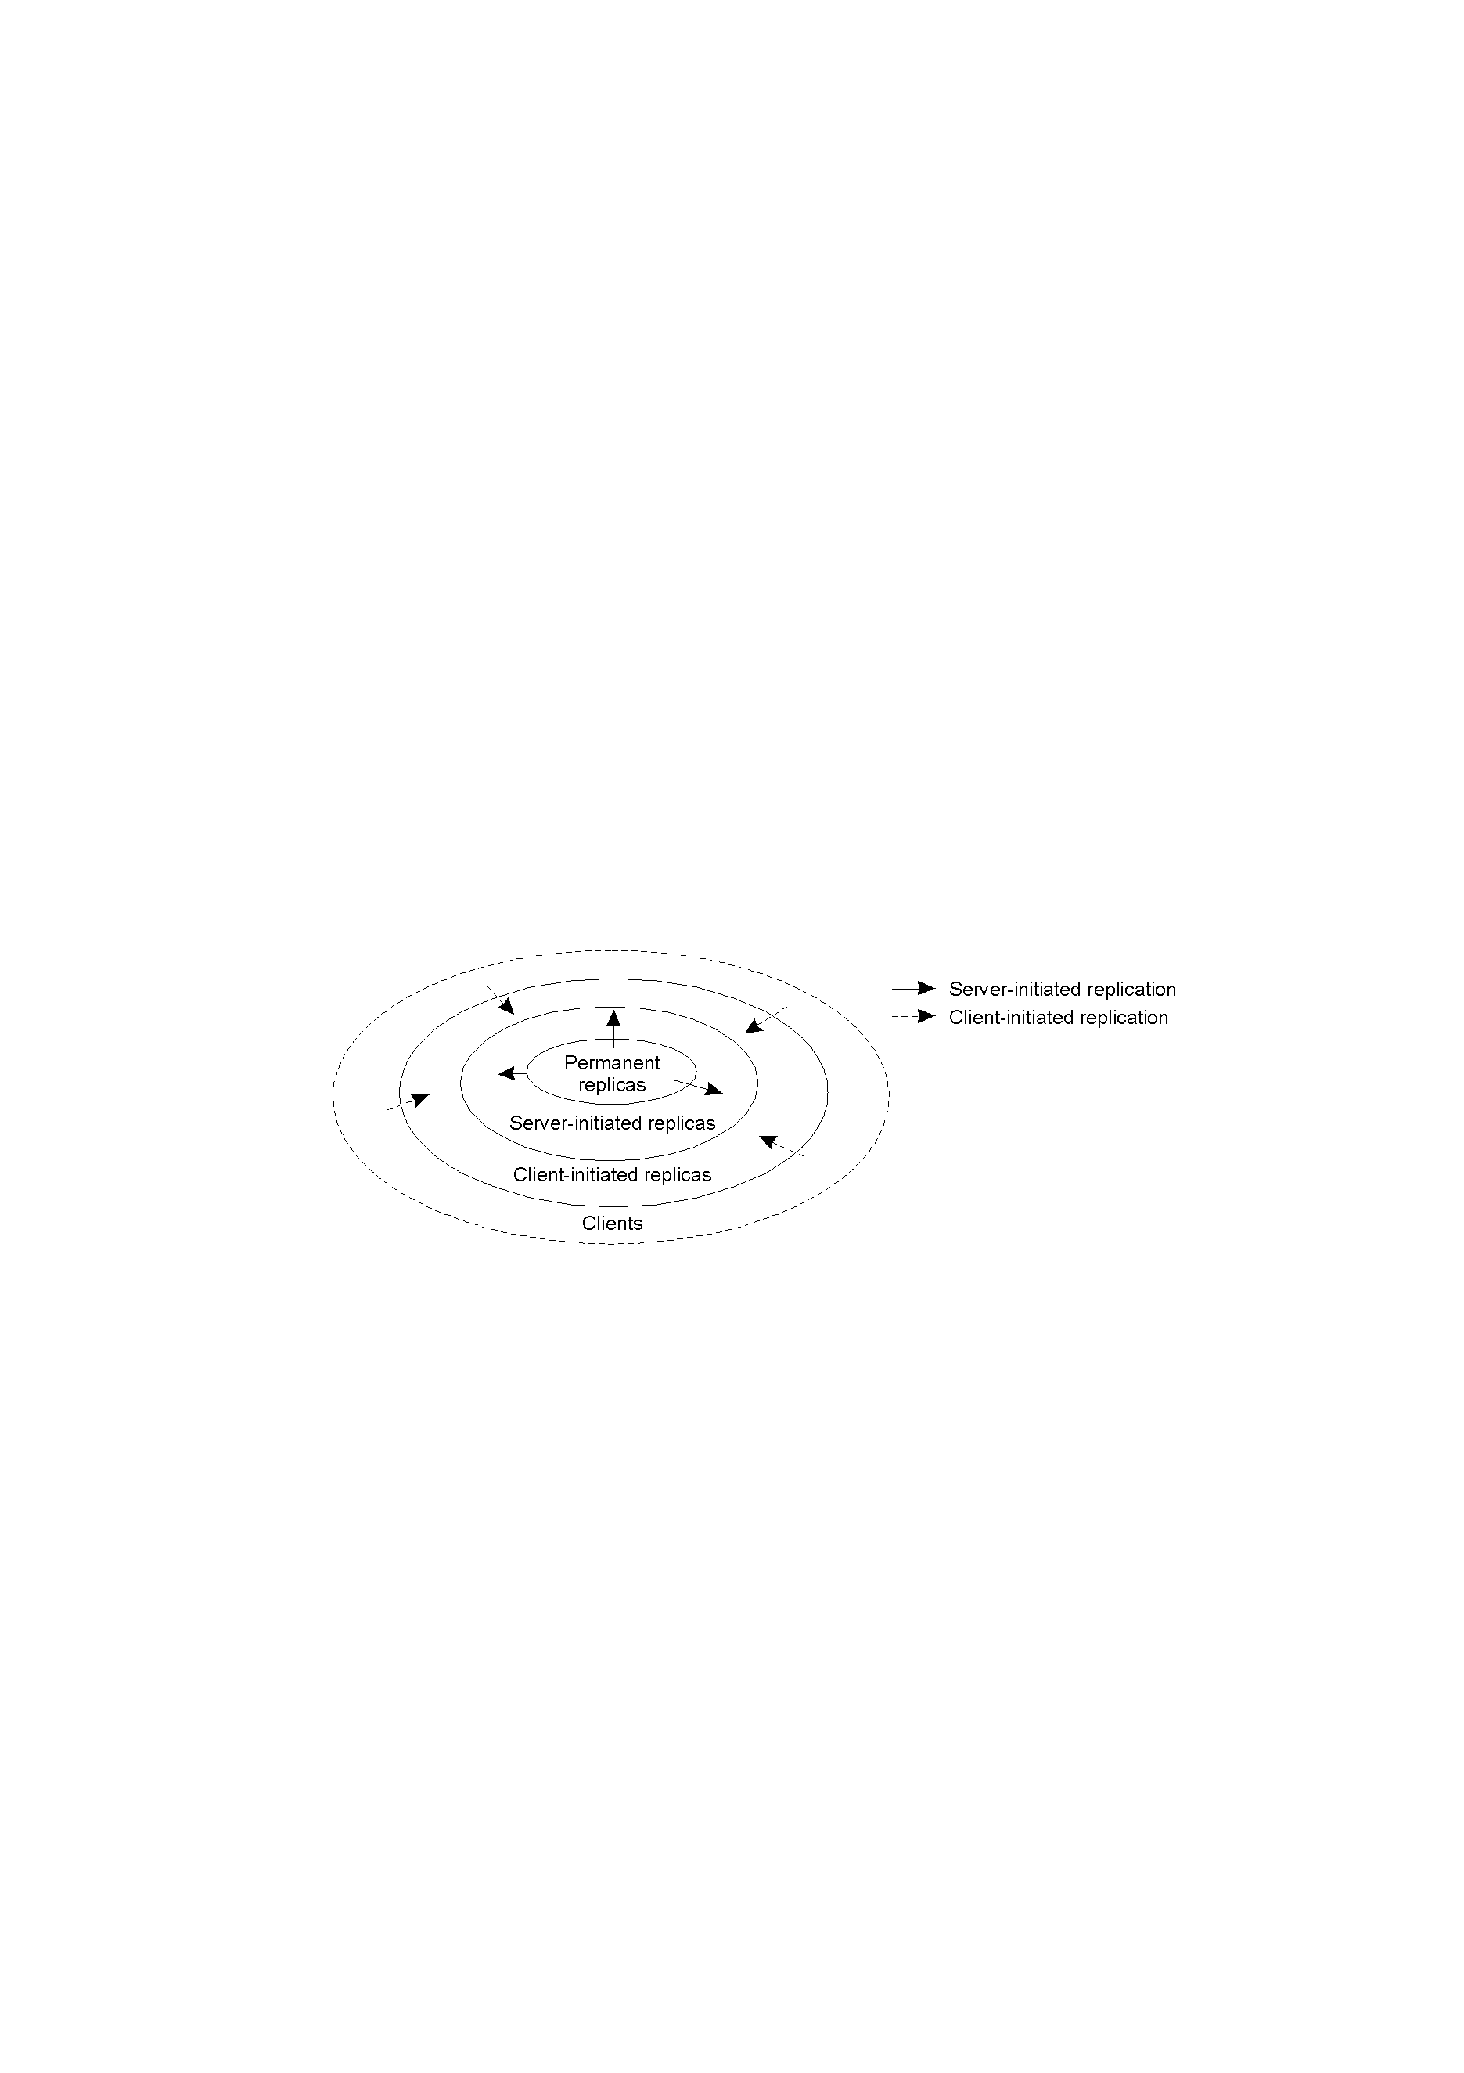
8.1 Replica Distribution (2)
Replicas are organized as three concentric rings in a data store.

Slide 7
8.1 Replica Distribution (3)
Permanent replicas
- initial set of replicas that constitute a distributed data store
- placed in a few core servers only.
Two ways to distribute permanent replicas:
On a single LAN, a limited number of servers holding the permanent replicas forward a copy to another server that does not have the permanent replicas but it requested for providing the same service (e.g., a Web site, BB at ECU).
The permanent replicas are copied to a number of servers which distributed in a WAN (e.g., distributed database, a mirror Web site, like Google maps).

Slide 8
8.1 Replica Distribution (4)
Server-initiated replicas are
A number of temporary replicas copied to servers in regions where requests are coming from.
Likely used for placing read-only copies close to clients.
Used to enhance performance in a local area for a short period of time. - e.g., a licensed software installed in a lab for a semester - Cf. permanent replicas - mainly for maintaining data consistency

Slide 9
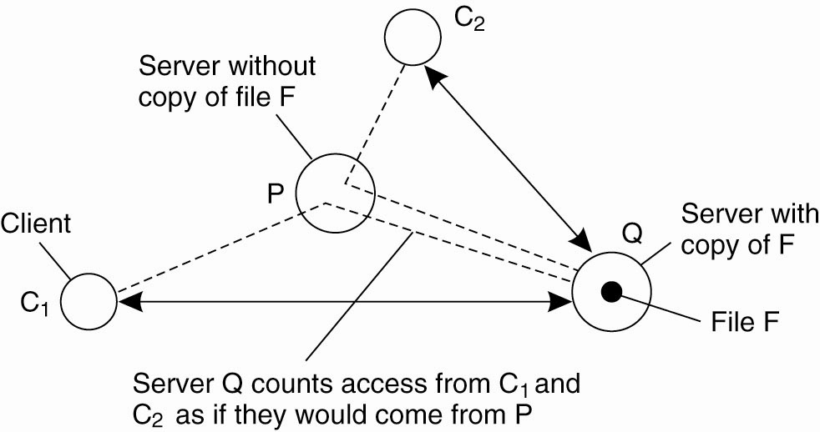
8.1 Replica Distribution (5)
Server-initiated replicas
Keep track of access counts per file, aggregated by considering server closest to requesting clients
Number of accesses exceeds a threshold R⇒ replicate file
Number of accesses between D and R ⇒ migrate file
Number of accesses drops below a threshold D ⇒ drop file

Slide 10
8.1 Replica Distribution (6)
Client-initiated replicas (known as caches)
A cache is a local storage facility that is used by a client to temporarily store a copy of the data it has just requested.
Client caches are used only to improve access time to data.
A client cache is normally placed on the same machine as its client, or on a machine shared by clients on the same LAN (e.g., proxy cache).
Data are generally kept in a cache for a limited time to prevent extremely stale data from being used, or simply removed to make room for other data.

Slide 11
8.2 Update Propagation (1)
General procedure of update propagation
Update operations on a distributed and replicated data store are generally initiated by a client and subsequently forwarded to one of the copies. From there the update should be propagated to other copies, while at the same time ensuring consistency.
When propagating an update, we must consider:
What can be propagated?
By whom should a propagation be initiated?
How to propagate an update?

Slide 12
8.2 Update Propagation (2)
What can be propagated? (1)
Propagate only a notification of an update
(often used for caches – notify changes of the copies)
Transfer data from one copy to another.
(distributed databases)
Propagate the update operations to other copies
(so local server executes the ops - also called active replication)
Observation: No single approach is the best, but depends highly on available bandwidth and read-to-write ratio at replicas.

Slide 13
8.2 Update Propagation (3)
What can be propagated? (2)
Propagate only a notification of an update
When an update has taken place in a server, a notification of that update is delivered to other servers to inform them that their copies, or part(s) of their copies by a specified notification, are invalid. (invalidation protocol)
Good: using little network bandwidth.
Bad: no actual update taking place on replicas.
Useful when the read-to-write ratio is low.

Slide 14
8.2 Update Propagation (4)
What can be propagated? (3)
2. Propagate updated data from one copy to others
Transfer the updated data in a server to other servers (and also log the changes and transfer the logs to other servers, etc.).
Pack multiple modifications into a single message and transfer the package once to other servers.
Good: actual update taking place on replicas.
Bad: using more network bandwidth.
Useful when the read-to-write ratio is high.

Slide 15
8.2 Update Propagation (5)
What can be propagated? (4)
3. Propagate update operation/s from one to others
When an update has taken place in a server, the operation that performs the update is transferred to other servers for doing update on their own copies in individual machines (active replication)
Good: i). using minimal network bandwidth;
ii). update taking place on all replicas.
Bad: individual machines need more processing power.
Useful: always.

Slide 16
8.2 Update Propagation (6)
By whom should a propagation be initiated? (1)
Server-based protocol (or push-based approach)
A server pushes its update to other servers and/or client caches without requests from these servers and clients.
Good: replicas keep a high degree of consistency.
Bad: i). using more network bandwidth;
ii). potential communication waste.
Useful when the read-to-write ratio is high, or when propagate permanent replicas.

Slide 17
8.2 Update Propagation (7)
By whom should a propagation be initiated? (2)
2. Client-based protocol (or pull-based approach)
A client or server requests another server to send any new update to the requesting server or client (cache).
Pre-fetching technique?
Good: potentially save communication costs.
Bad: some degree of inconsistency;
Useful when the read-to-write ratio is low.

Slide 18
8.2 Update Propagation (8)
By whom should a propagation be initiated? (3)
3. Client-server lease approach
A lease is a promise by the server that it will push updates to the client for a specific period of time.
Good: save communication costs.
Bad: i). some degree of inconsistency;
ii). require stateful servers to keep client
information, thus cause overhead at server.
Useful when the read-to-write ratio is relatively low in the specific period.

Slide 19
8.2 Update Propagation (9)
How to propagate an update? (1)
Unicasting
A server that is part of the data store pushes its update to N (not all) other servers by sending N separate messages to those individual servers.
More suitable to pull-based approach (or client-based protocols)
In such cases, only a single client or server requests its copy to be updated.
may be the most efficient solution.

Slide 20
8.2 Update Propagation (10)
How to propagate an update? (2)
Multicasting or broadcasting
Underlying network takes care of sending updates efficiently to multiple receivers.
Can be combined with push-based approach for propagating server-initiated updates to a number of other servers.

Slide 21
8.3 Consistency Protocols (1)
What is a consistency protocol?
- Describes an implementation of a specific consistency model.
Classification of consistency protocols
Primary-based protocols
Each data item x in the data store has an associated primary server for coordinating write operation on x on only one copy.
Replicated-write protocols
Write operation can be carried out at multiple replicas instead of only one copy.

Slide 22
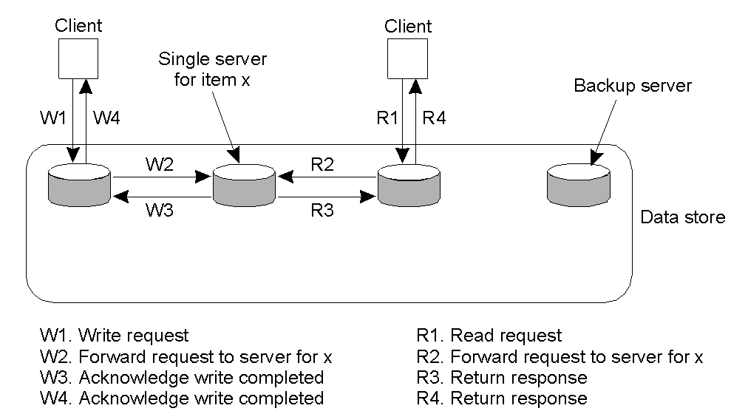
8.3 Consistency Protocols (2)
Primary-based protocols
Remote-write protocols
(1) Basic protocol - No replica, with only one copy in a (remote) single server.

Slide 23
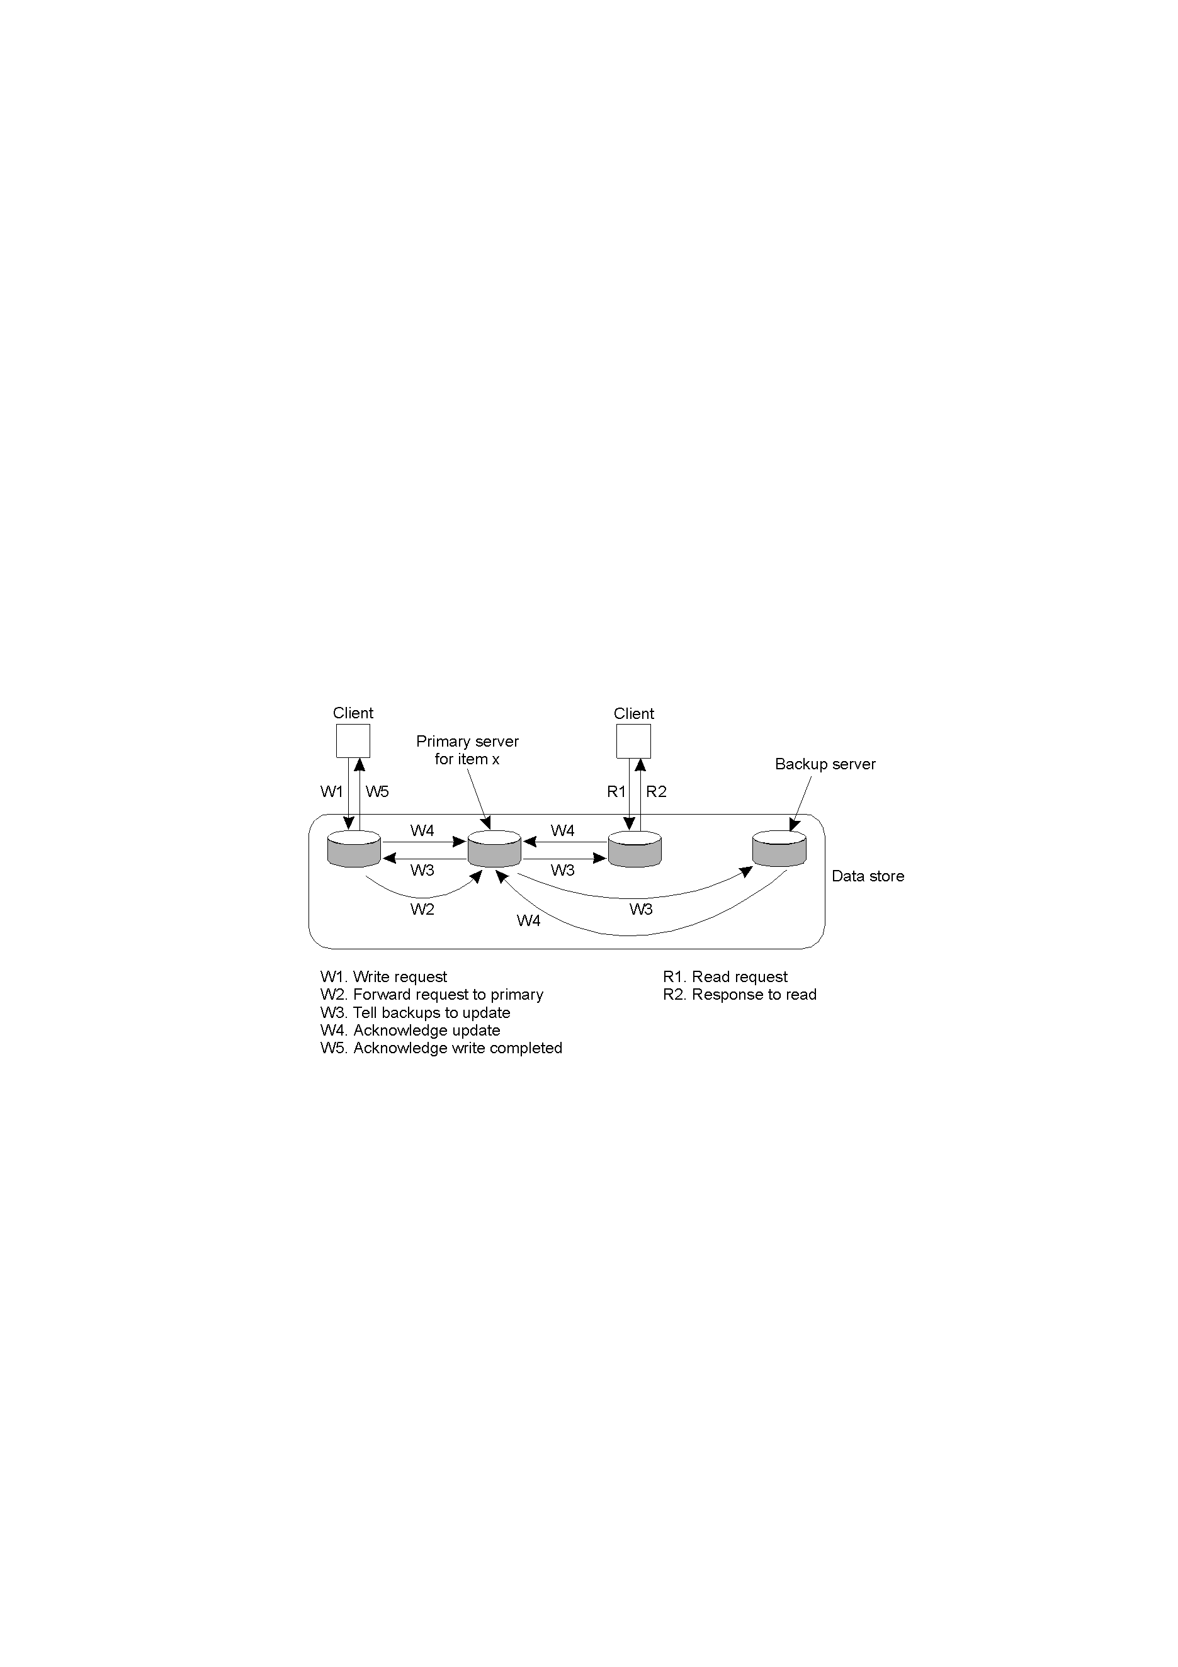
8.3 Consistency Protocols (3)
Primary-based protocols (cont)
Remote-write protocols
(2) Backup protocol – (with replicas) read is allowed on local copy but write should be forwarded to other copies.

Slide 24
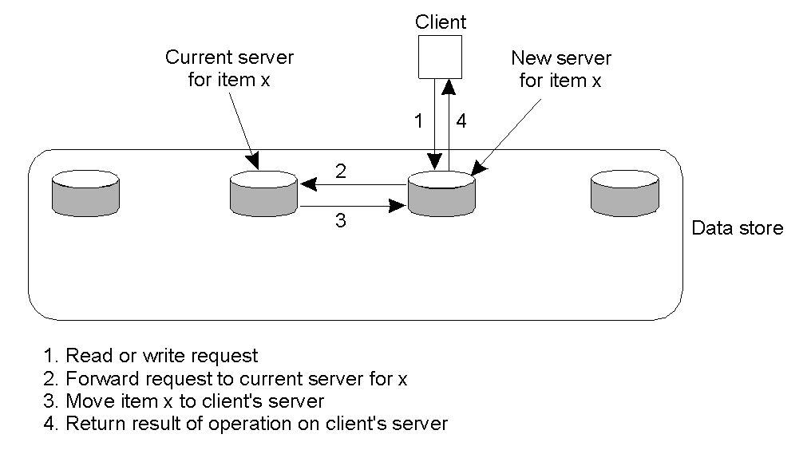
8.3 Consistency Protocols (4)
Primary-based protocols (cont…)
2. Local-write protocols
(1) Basic protocol - No replica, with only one copy that can be migrated between multiple (remote) servers.

Slide 25
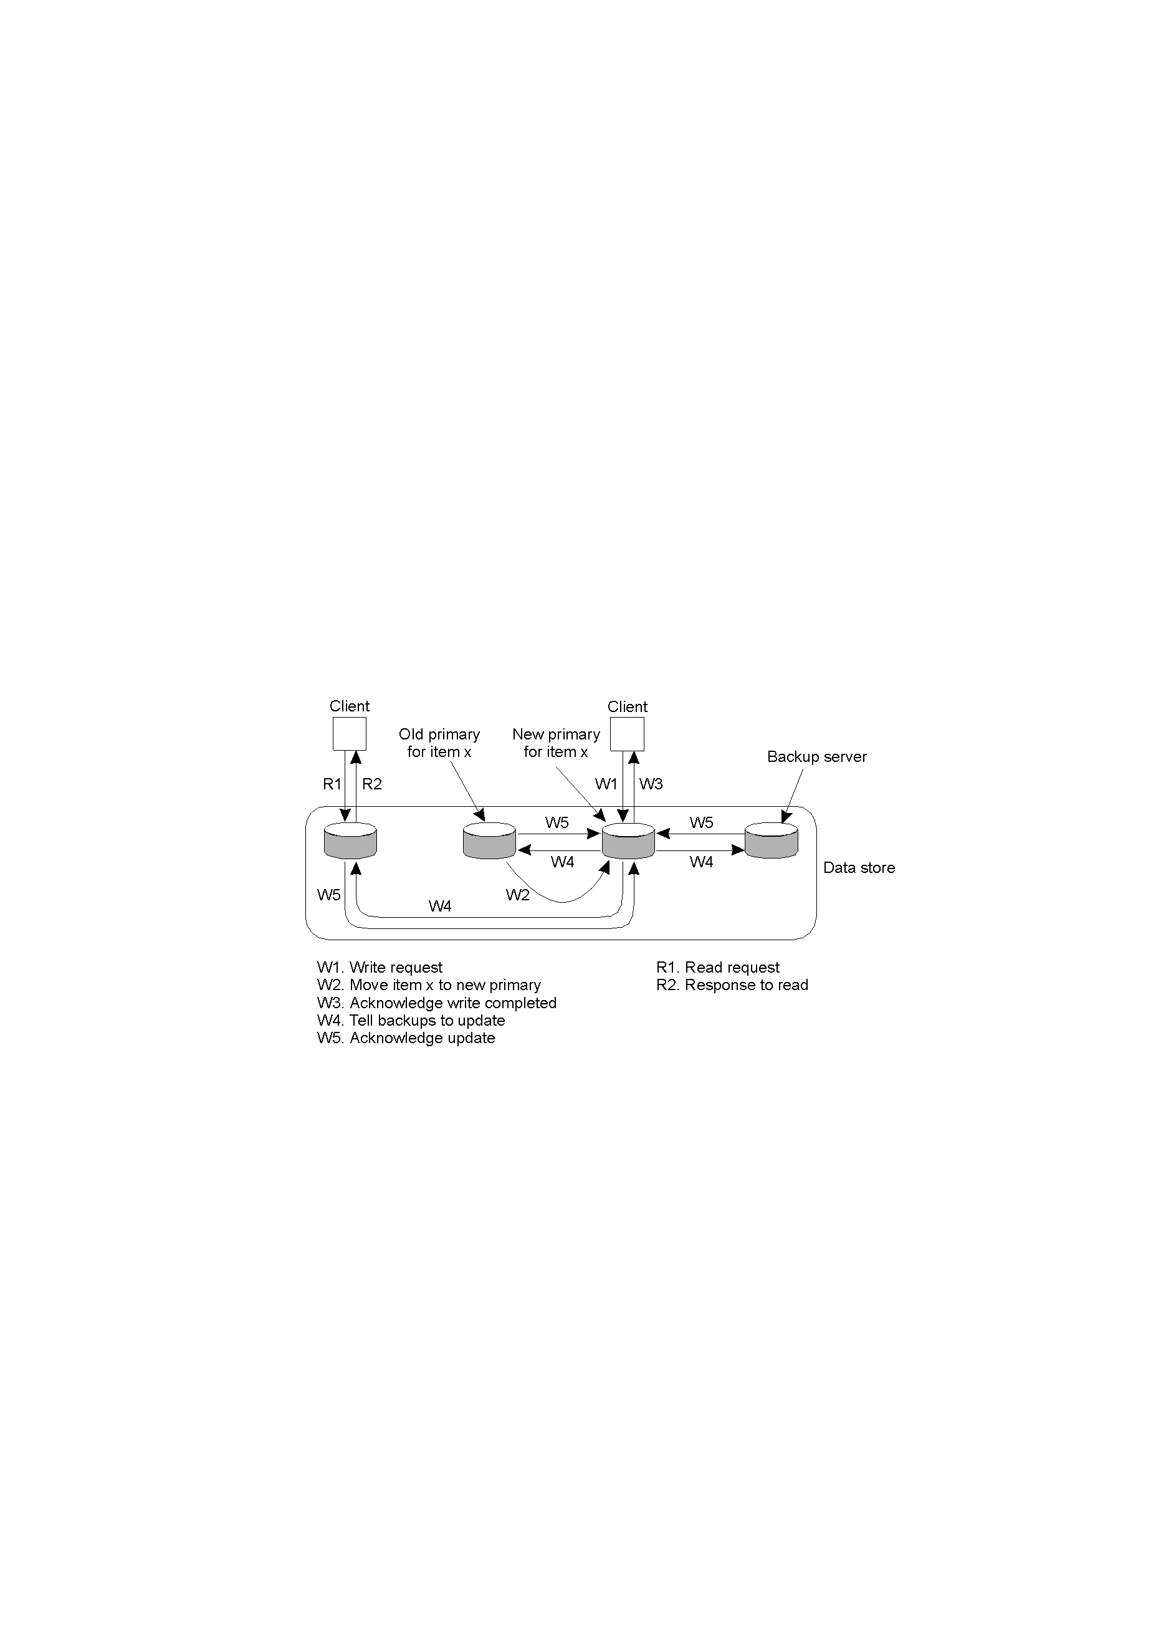
8.3 Consistency Protocols (5)
Primary-based protocols (cont)
2. Local-write protocols
(2) Backup protocol – (with replicas) read free, but write will not start until the primary copy of data item is migrated to the local server.

Slide 26
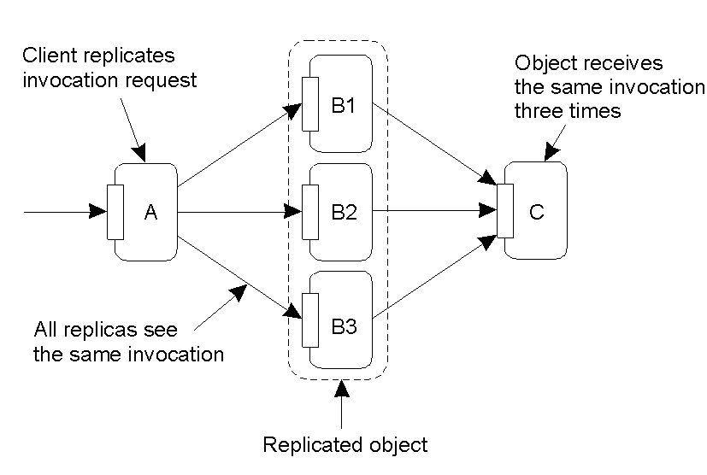
8.3 Consistency Protocols (6)
Replicated-write protocols
Problem with replicated invocations
Notes:
??

Slide 27
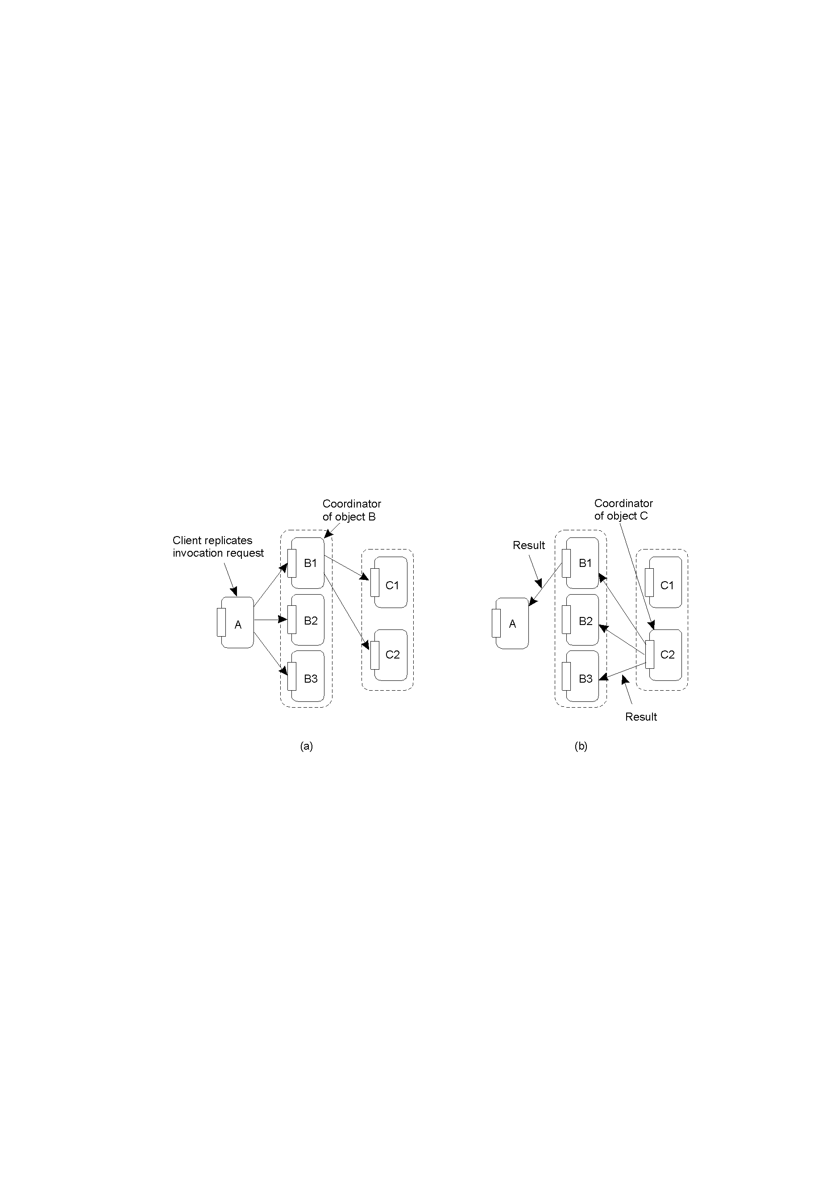
8.3 Consistency Protocols (7)
Replicated-write protocols
Solution to the problem with replicated invocations
Achieve total ordering of operations using a coordinator (or sequencer) to replicas of objects
Notes:
??

Slide 28
8.3 Consistency Protocols (8)
Quorum-based protocols (1)
A client must request and obtain the permission of multiple servers before either reading or writing a replicated data item.
To update a file, a client
must first contact at least half, i.e., N/2, of the servers plus 1 (i.e., N/2 + 1 thus a majority) and get them to agree to do the update;
then can change the file and assign a new version number to the new file, which is the same for all the newly updated files with the N/2 + 1 servers.
Notes:
Quorum: the minimum number of members of an assembly or society that must be present at any of its meetings to make the proceedings of that meeting valid.

Slide 29
8.3 Consistency Protocols (9)
Quorum-based protocols (2)
To read a replicated file, a client
must also first contact at least half (N/2) of the servers plus 1 (i.e., N/2 + 1 thus a majority) and get them to send the version numbers associated with the file;
If the version numbers are
all the same, indicating the file is the most recent version, then can read the file;
different, then read the file with the newest version number.

Slide 30
8.3 Consistency Protocols (10)
Quorum-based protocols (3)
Gifford’s Quorum Scheme (voting algorithm)
To read a file of N replicas, a client needs to obtain a read quorum, an arbitrary collection of any N_{R} servers or more.
To modify a file of N replicas, a write quorum of at least N_{W} servers is required.
Legal schemes if follow the constraints below:
N_{R} + N_{W} > N (prevent read-write conflicts)
N_{W} > N/2 (prevent write-write conflicts)
Guarantees: at least one new copy is read/written

Slide 31
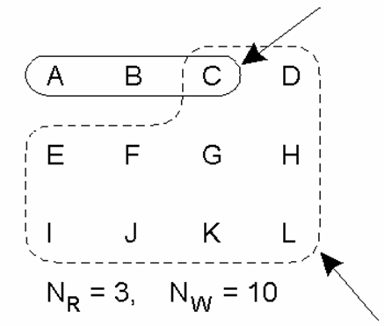
8.3 Consistency Protocols (11)
Quorum-based protocols (4)
Example 1: A legal scheme
N_{R} + N_{W} > N (prevent read-write conflicts)
N_{W} > N/2 (prevent write-write conflicts)
Read quorum
N=12
Write quorum

Slide 32
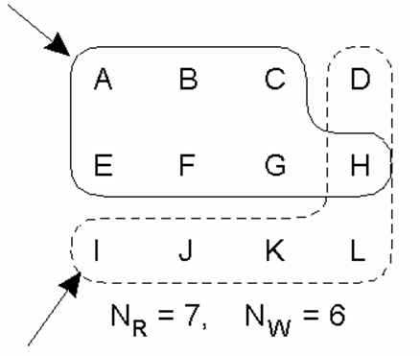
8.3 Consistency Protocols (12)
Quorum-based protocols (5)
Example 2: A scheme may have write-write conflicts
N_{R} + N_{W} > N (prevent read-write conflicts)
N_{W} > N/2 (prevent write-write conflicts)
Read quorum
Write quorum
Notes:
As Nw is not greater than N/2=12, the read operation may get different version of the value of item X (see H).
However, this scheme does not qualify for Gifford’s Quorum scheme. – issue is: assume that servers of ABCEFG were written/update last time, with version No. k; and servers of DHIJKL were written/update recently, with version No. k+1; then possibly the next written/update might be done in servers ABCEFG again, thus to get a new version No. k+1 as well (as they were all updated from files of version No. k). In thus a case, in the next reading, all reading would have files of version No. k+1, but they are actually not the same update result. - in other words, condition Nw > N/2 guarantees that all updated would increase version no. of files (based on the newest version no. of the involved files.)

Slide 33
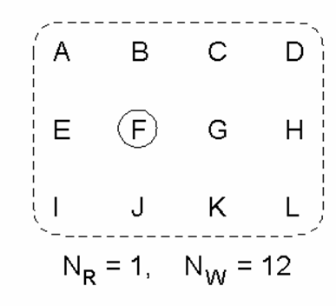
8.3 Consistency Protocols (13)
Quorum-based protocols (6)
Example 3: A legal scheme, known as ROWA (read one, write all)
N_{R} + N_{W} > N (prevent read-write conflicts)
N_{W} > N/2 (prevent write-write conflicts)

Slide 34
Major Points
Classification of replicas
What can be propagated?
By whom should a propagation be initiated?
How to propagate an update?
What is the major difference between primary-based protocols and replicated-write protocols?
How to decide a legal quorum scheme?

Slide 35
Reading Guide
Normal Reading
DSPP: 7.4.2-3, 7.5.2-3
Advanced Readings
DSPP: 7.4.1, 7.5.1, 7.5.4-5

